Slide 1
Lecture 2
Professional Software Development and Practice
Muhammad Qasim
BSCS (Software Engineering-I) SZABIST-Islamabad

Slide 2
Previous Lecture
Difference between Program and Software
Software Wearing
Software Categories
Legacy Systems
Software Engineering
Framework Activities
Umbrella Activities
BSCS (Software Engineering-I) SZABIST-Islamabad

Slide 3
Software Process
A software process is a road map that helps you create a software.
It is the way we produce software and it provides stability and control.
Each process defines certain deliverables known as the work products. These include programs, documents, and data produced as a consequence of the software engineering activities. a timely, high quality result.
BSCS (Software Engineering-I) SZABIST-Islamabad

Slide 4
Software Development Life Cycle
Software Development Life Cycle (SDLC) is a process used by the software industry to design, develop and test high quality software.
The SDLC aims to produce a high-quality software that meets or exceeds customer expectations, reaches completion within times and cost estimates.
BSCS (Software Engineering-I) SZABIST-Islamabad

Slide 5
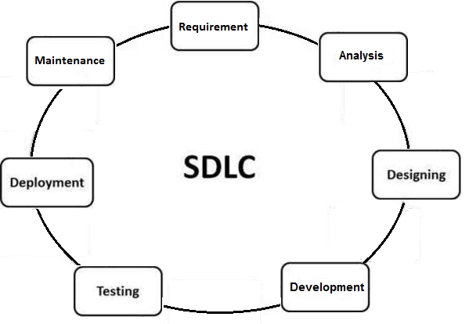
Software Development Life Cycle
BSCS (Software Engineering-I) SZABIST-Islamabad

Slide 6
Software Development Life Cycle
Requirement Gathering: In this phase requirement/demands for new software are collected from Stakeholder. This could be done in the form of Interview, meetings, document review, existing system review etc. All the information is documented.
These are general questions that get answered during a requirements gathering phase.
  Who is going to use the system?
  How will they use the system?
  What data should be input into the system?
  What data should be output by the system?
.
BSCS (Software Engineering-I) SZABIST-Islamabad

Slide 7
Software Development Life Cycle
2. Requirement Analysis:
In this Phase requirements are analyzed for their validity and the possibility of incorporating the requirements in the system to be development is also studied.
Finally, a Requirement Specification document is created which serves the purpose of guideline for the next phase of the model like Designing, Development and Testing.
For Agile: Test team follows the Software Testing Life Cycle and starts the Test Planning phase after the requirements analysis is completed.
BSCS (Software Engineering-I) SZABIST-Islamabad

Slide 8
Software Development Life Cycle
Business Analyst:
A business analyst (BA) is someone who analyzes an organization or business domain and documents its business or processes or systems, assessing the business model or its integration with technology.
Roles of Business Analyst:
  Meeting
  Analyzing Requirement
  Document Creation
  Requirement Review with team
BSCS (Software Engineering-I) SZABIST-Islamabad

Slide 9
Software Development Life Cycle
3) Design: In this phase the system and software design is prepared from the requirement specifications which were studied in the first phase. System Design helps in specifying hardware and system requirements and also helps in defining overall system architecture. The system design document specifications (DDS) serve as input for the next phase of the model.
Example: Front end → C++
Backend → Oracle database
→ how many table?
→ how to store and fetch data?
Role: System Architect
BSCS (Software Engineering-I) SZABIST-Islamabad

Slide 10
Software Development Life Cycle
4) Development/ Coding: In this stage of SDLC the actual development starts and the product is built. The programming code is generated as per DDS during this stage. If the design is performed in a detailed and organized manner, code generation can be accomplished without much hassle.
Developers must follow the coding guidelines defined by their organization and programming tools like compilers, interpreters, debuggers, etc. are used to generate the code. Different high level programming languages such as C, C++, Pascal, Java and PHP are used for coding. The programming language is chosen with respect to the type of software being developed.
Role: Developer
BSCS (Software Engineering-I) SZABIST-Islamabad

Slide 11
Software Development Life Cycle
5) Testing: In this Phase of SDLC ready software is tested against the requirements (SRS) to make sure that the product is actually solving the needs addressed and gathered during the requirements phase. During this phase all types of functional testing like unit testing, integration testing, system testing, acceptance testing are done as well as non-functional testing are also done.
Role: Tester
BSCS (Software Engineering-I) SZABIST-Islamabad

Slide 12
Software Development Life Cycle
6) Deployment: In this Phase of SDLC product/software is delivered/handover to the customer for their use.
Role: No Specific Role (all team involved)
7) Maintenance: Once when the customers starts using the developed system then the actual problems comes up and needs to be solved from time to time. This process where the care is taken for the developed product is known as maintenance.
Role: Customer Service/ Technical Support Team
BSCS (Software Engineering-I) SZABIST-Islamabad

